Slide 1
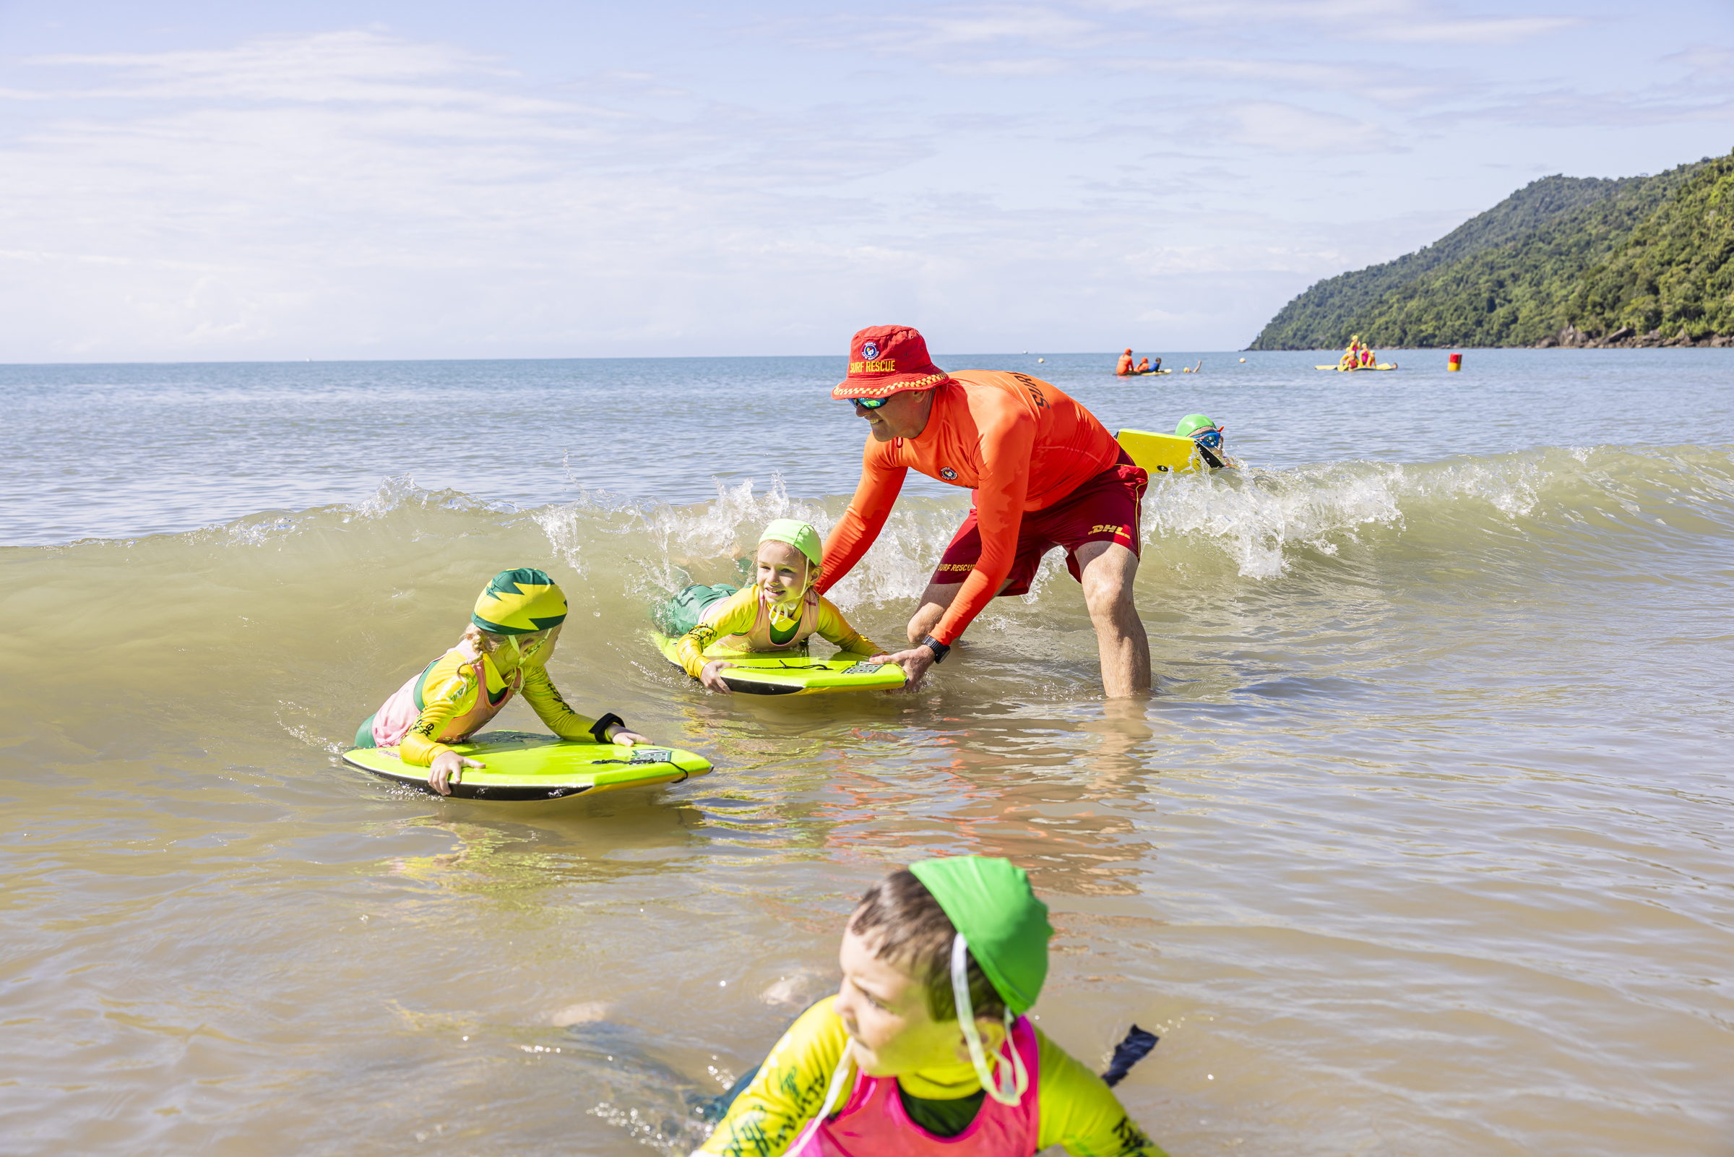
FAMILY INCLUSION PROGRAM

Slide 2
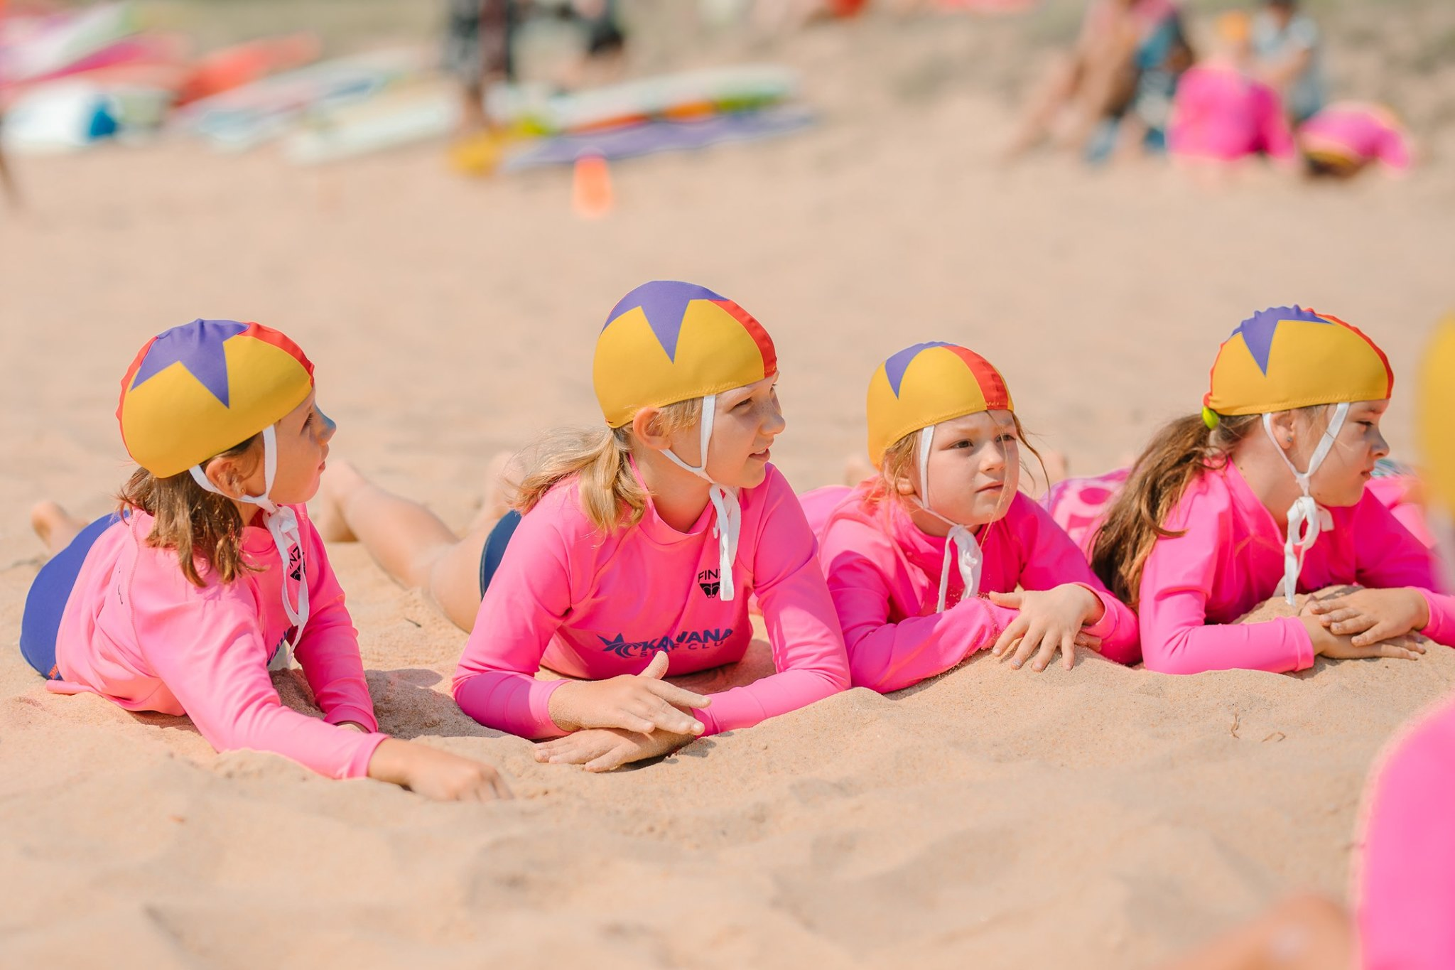
CLUB HISTORY
Add Club history here

Slide 3
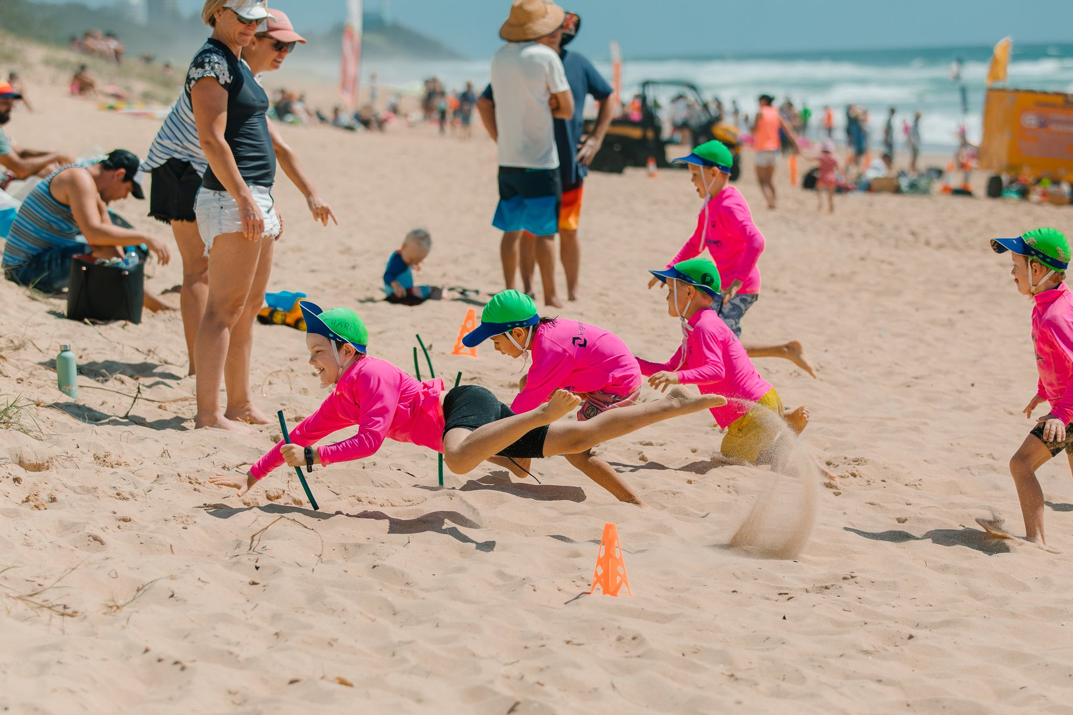
Surf Life Saving Queensland
Surf Life Saving in Queensland is made up of 58 Clubs from Port Douglas to Rainbow Bay.
6 Branches – North Queensland, North Barrier, Wide Bay Capricorn, Sunshine Coast, South Coast and Point Danger.
Just over 36,000 Members including active patrolling, associate and juniors in Queensland.
Over 3000 rescues.
Over 585,000 preventative actions.
Over 152,000 lives saved since 1930.

Slide 4
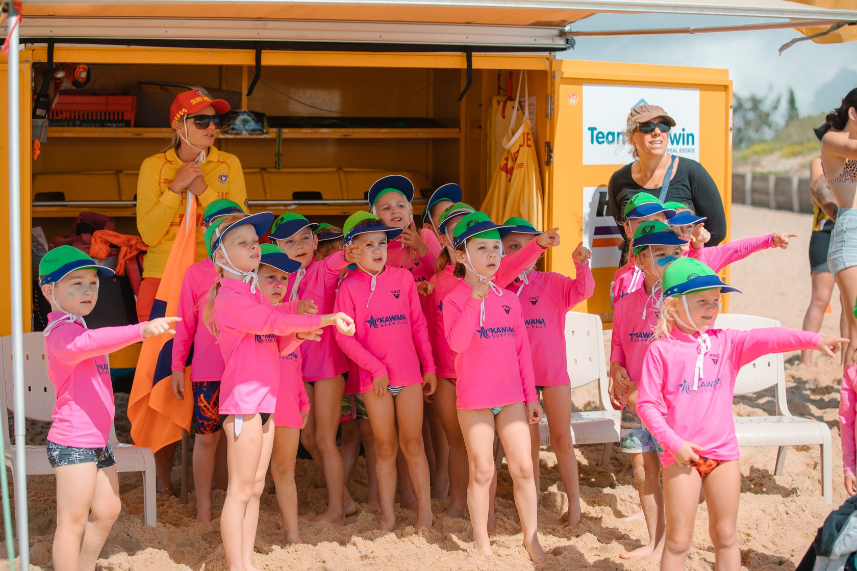
About Junior Activities
Junior activities is from U6s up to U14s
More than 12,850 junior activity Members across Queensland
That equates to 35% of our membership
30% of our membership are junior activities parents

Slide 5
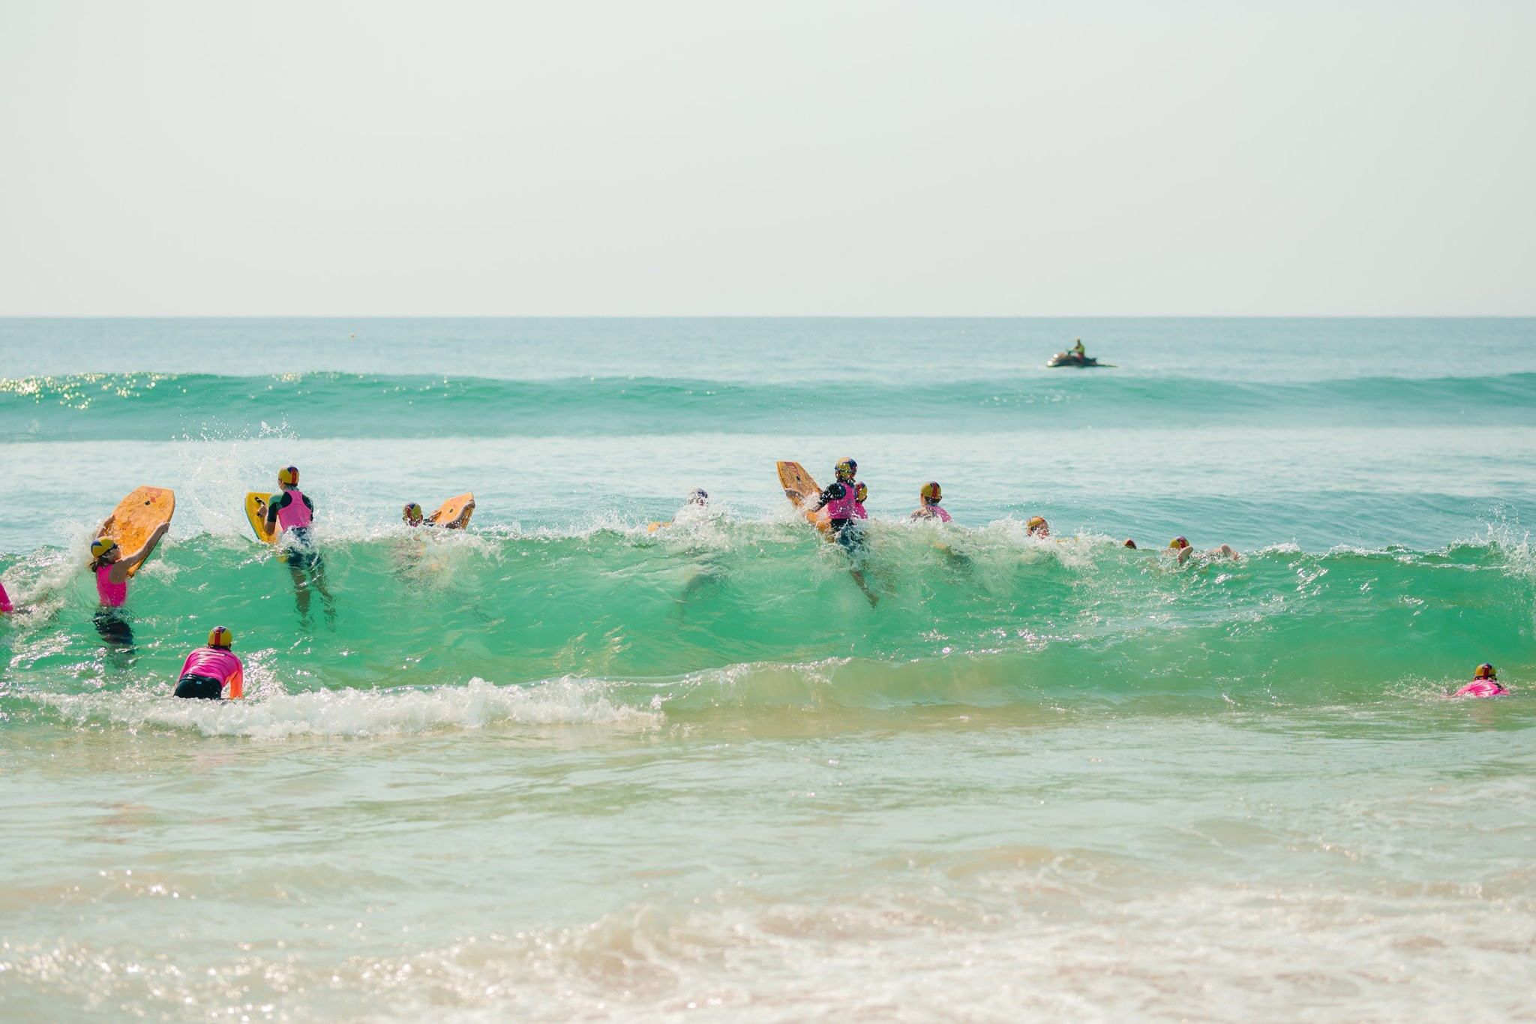
The Three Fs
Our juniors have told us there are three things that are important to them when it comes to junior activities.
FUN
FAMILY
FRIENDS

Slide 6
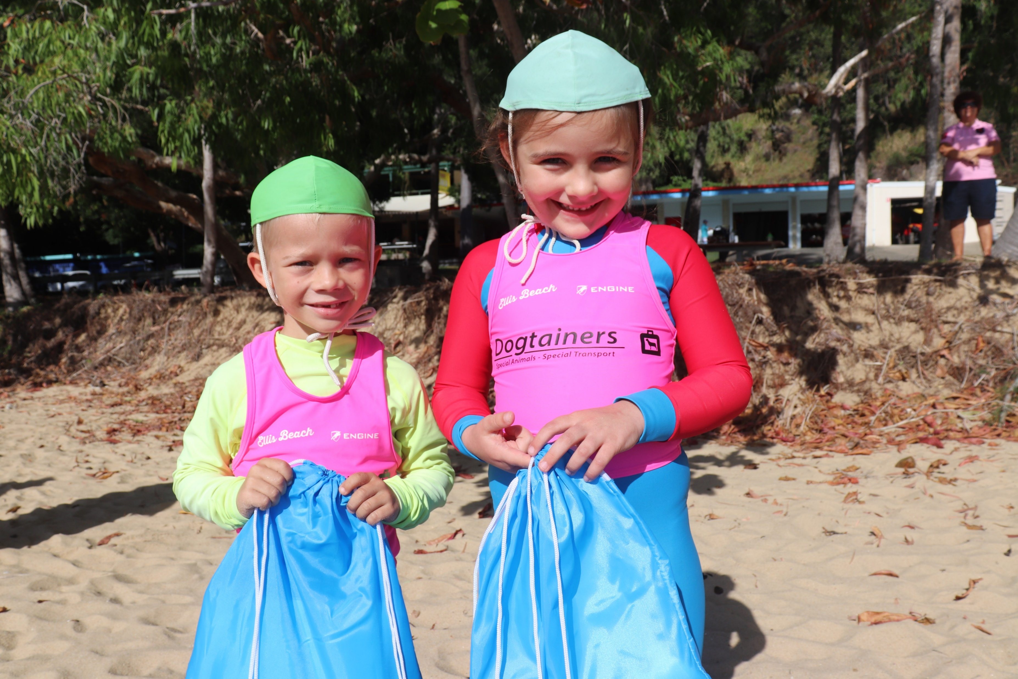
Benefits of junior activities
Lifesaving knowledge development – surf awareness skills and beach safety
Lifesaving skills development – from surf skills in the water to resuscitation and basic first aid.
Friendship – through a range of formal and informal activities and social events
Fun – through a strong focus on participation for all juniors
Family – Involvement in sport builds families as well as communities. Active parents provide positive role models for children for engaging in sport and for maintaining lifelong activity. As importantly, the parents who are involved in their children’s sport through coaching, umpiring and general volunteering send a powerful message about the importance they place on sharing and valuing the efforts and interests of their children. According to ASC research children whose parents are involved in their sporting and recreational endeavours will remain involved for much longer.

Slide 7
Junior activities: the end result
Overall, our Junior Activities programs aim to build:
Life Skills
Friends for Life
Career Opportunities
Leadership
Family Connections
Confidence
Future Lifesavers
Fitness

Slide 8
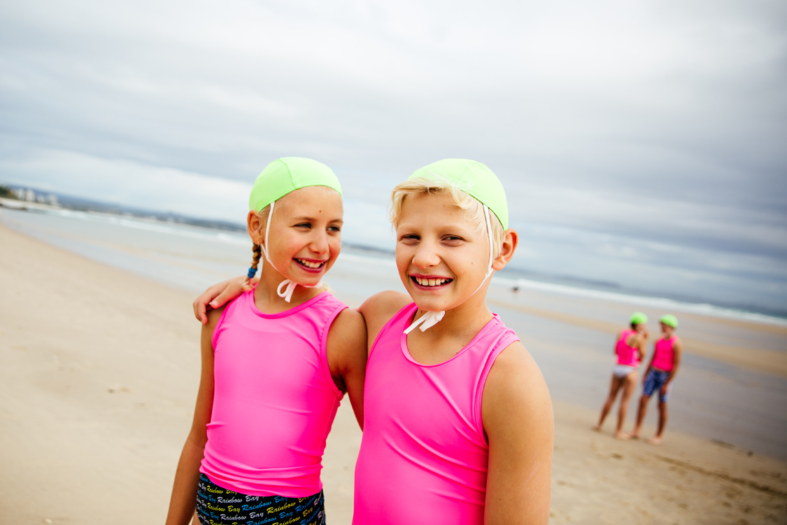
What happens on a Nipper morning?
Clubs to add in key points for what happens on a Nipper morning
Notes:
Junior activities focuses on participation and skill development
Rotate through stations of skills; board paddling, swimming, beach flags, wades and sprints
Exercises at each area should focus on fun, not just competing
An education component is also part of the program:
- Each age group completes education awards ranging from basic surf awareness knowledge in the young age groups up to more formal qualifications in the older groups such as their resuscitation award in U13’s
- May like to highlight the difference here between Sunday morning nippers and say mid-week surf sports training programs and how members may like to involve themselves in these

Slide 9
Creating a safe environment
Safeguarding is serious
We are committed to keeping juniors safe from all forms of harm
Code of Conduct for PPA
In place to guide our conduct towards Junior Members
Child & youth risk management includes:
All Members participating in Junior Activities over 18 must obtain a Blue Card
Anonymous reporting of child safety concerns
Child and Youth Risk Management Strategy (hyperlink your clubs statement here)
Photography only with Parental Consent
Policies & procedures to support a safe environment

Slide 10
Creating a safe, Respectful & Inclusive environment
Competence Standards
Pool, Preliminary and competition requirements
Qualified Age Managers, Coaches and Assistants
Full duty of care – Sign on & sign off of Nippers
Water safety standards include:
1 officer to 5 children (1:5 ratio) (SLSA policy 1.01 Water Safety)
High visibility rash shirts and caps (MS13 SLSQ High Visibility Clothing Policy) mandatory for training and Nipper Sundays
Risk assessments documented
Sun Safety
Sun Safety Policy
Notes:
Junior Activities members should be in a safe environment where they feel comfortable to speak out.
We care about physical and emotional safety and are committed to
Encourage all members to undertake the Safeguarding Children and Young People awareness module, to increase awareness of child abuse and ways to make your club a child safe organisation

Slide 11
Surf sports
Range of surf sports events for juniors are held throughout the season including age specific carnivals and team carnivals
Accredited Coaching & Official Courses Available for parents
Clubs to insert an overview of how Nippers and Parents can get involved in Surf Sports at their club
Notes:
Branch and State Titles are major events (qualifying required for State)
Surf sports training – outside of Sunday morning junior activities
Overview of process for participating in carnivals through the club

Slide 12
Play Your Part! How can you get involved
On average, it takes over 70 people to run a Junior Activities program of 300 junior members (club to add in how many on JA roles and how many Nippers at their club)
Involvement can provide you with fitness, new skills development and new, interesting experiences
Range of formal and informal roles within Junior Activities and within the wider club
Something for everyone
Insert who to talk to if parents wish to get involved.
You do not need a Bronze Medallion to be an effective part of Surf Life Saving.

Slide 13
Roles to assist nippers
Age Managers
Age Manager Assistant
Nipper Age Assistant Inductee (NAAI)
Water Safety Assistant to Age Manager
Official Carnivals
Core
Technical
Senior
Patrolling lifesaver – Award
Patrolling lifesaver – Surf Rescue Certificate (SRC)
Water Safety Nippers and Competition
Patrolling lifesaver – Bronze Medallion (BM)
Water Safety Nippers and Competition
IRB Operator
Driver and Crew
Coach
Development
Performance
High Performance
Team Manager
Junior Activities Committee positions
Executive and Plenary positions
Junior Activities non-committee positions
Fundraising – Club canteen/barbeque
Other assistance
Training and Nippers setup and pickup etc
Carnival assistance setup and trailers etc
Notes:
• Committee Members • Age Managers • Team Managers • Fundraising • BBQ, Canteen • Coaches • Officials • Gear Stewards • Water Safety • Beach Set-u
Patrolling Lifesaver: (SRC & Bronze Medallion) The Surf Rescue Certificate and Bronze Medallion (including the Certificate II in Public Safety) are the two entry level awards for someone who wishes to become a fully qualified patrolling lifesaver and/or water safety officer.
• Award Lifesaver: For those members who are not strong swimmers but who still want to patrol the beach, you are able to complete lifesaving awards which do not include a swimming component. Such awards include First Aid, Resuscitation and Radio awards. Members who hold these awards are still able to patrol the beach by specialising in certain areas.
• Trainer: If you enjoyed teaching the children about lifesaving skills, then you may wish to consider becoming a trainer for other awards. Trainers are required to complete a Training Officer’s Certificate and they need to hold the award that they are training.
• Assessor: Assessors are the people responsible for assessing the competency of the Surf Life Saving and Nationally Accredited awards. To become an assessor, you are required to complete an assessor’s course and you will need to hold the award that you intend to assess. Members who wish to extend their skills in assessing may wish to do a full Certificate IV in Training and Assessment.
• Coach: Coaches provide an important role in developing and improving the skills of members in surf sports. Coaching accreditation comes in three levels (Level 1, Level 2, and Level 3). Level 1 coach’s accreditation is the level most suited to new coaches at club level.
• Official: Officials are those people responsible for the conduct of surf sport events. There are a range of different roles undertaken by officials including referees, starters, judges, recorders, marshals, across all of the surf sports disciplines.
• Administrator: If you are interested in the administration of the club, there are a range of different roles that you may be able to get involved with. These might include some specific roles for junior activities such as an Age Managers coordinator or the Junior Activities chairperson. You may also like to play a responsibility specific role such as a treasurer or secretary.

Slide 14
Who Can I ask? Queries & concerns
In the first instance, speak with your child’s age manager, age manager may refer you to a committee member.
Refer to Club specific process.
We understand people always want to help and do this with the best intentions.
However, best to ask first to save time later.
Range of policies in place around:
Fundraising and sponsors
Logo and surf Life Saving/club brand use inc clothing
Safety processes i.e. for training and other activities
Chaperoning and camps
Notes:
WHO DO I ASK: There is every chance that the people volunteering in the positions listed below will be able to answer your questions or alternatively they will direct you to the person that can?
• Age Managers • Team Managers • Water Safety • Coaches • Committee Members (Sometimes difficult to identify)
Metropolitan Caloundra SLSC, Surf Life Saving QLD and Surf Life Saving Australia all have websites. These websites are full of helpful information and resources.
It is also recommended that you become familiar with the “Nipper Handbook” and the “Nipper Calendar” which is displayed on the clubs website.

Slide 15
THANK YOU AND WELCOME TO THE CLUB

